Slide 1
Visualizing Trends of Car Accidents in Michigan
STT 180 - Group 4
Katie Pocock, Stella Jamsen, Holly Sederlund, Bergen Kendziorski, Brett Pawlowski

Slide 2
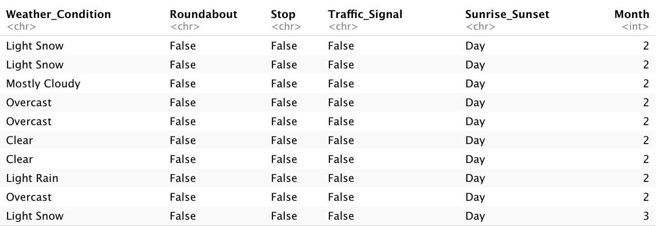
Our Dataset
Traffic accidents in MI from Feb. 2016 - Dec. 2021
Variables note the conditions when the accident took place.

Slide 3

Research Questions
Main Question: What are the most significant factors of predicting a car crash?
How does weather conditions and/or visibility affect the amount/severity of car accidents?
What weather conditions do the most accidents occur?
What time of day and time of year do most accidents occur?
Is there a specific side of the car that gets hit more often?
What counties in Michigan have the most amount of accidents?
What type of intersection has the most occurrences of car crashes?

Slide 4

What We Expect To Find
Weather conditions will play a major role
More accidents during winter months
Right-side accidents more frequent
More accidents when there is less visibility
More accidents at night

Slide 5


Methods
Data Manipulation
Cleaning our dataset to not include any redundant information
Organizing data when we want to look at specific variables
Create new datasets for plotting

Slide 6

Methods
Data Visualization
Create plots in order to visualize the differences and relationships between the variables
We will analyze these relationships (if they exist) and use them to draw conclusions

Slide 7
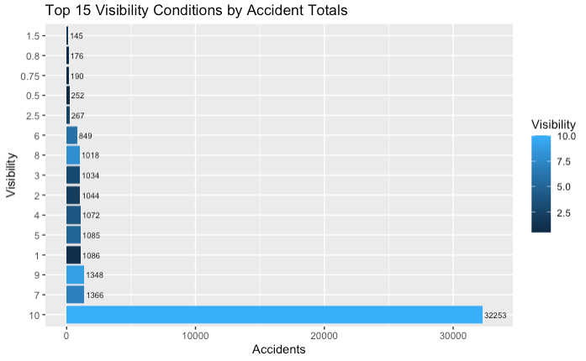
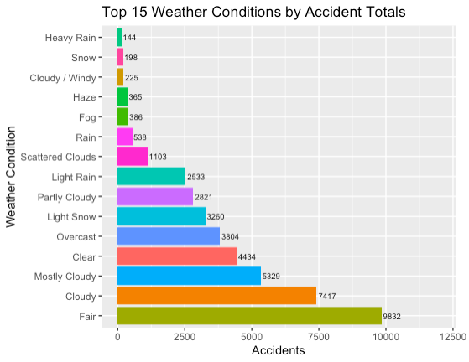
Results
In what visibility do most accidents occur?
In what weather conditions do the most accidents occur?

Slide 8
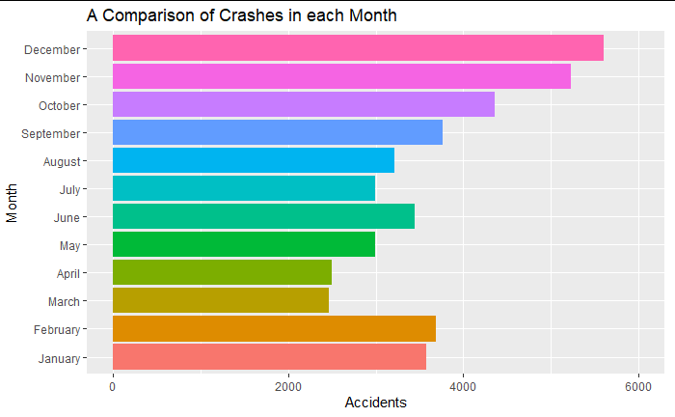
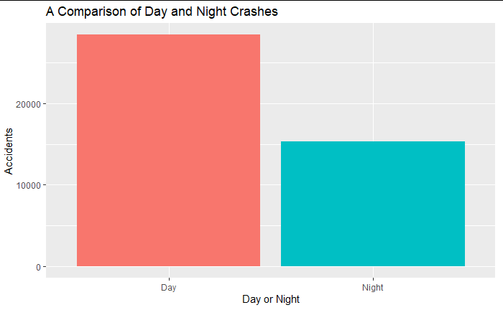
Results
In what time of year do most accidents occur?
What time of day do most accidents occur?

Slide 9
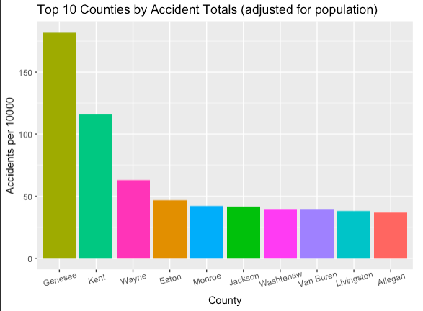
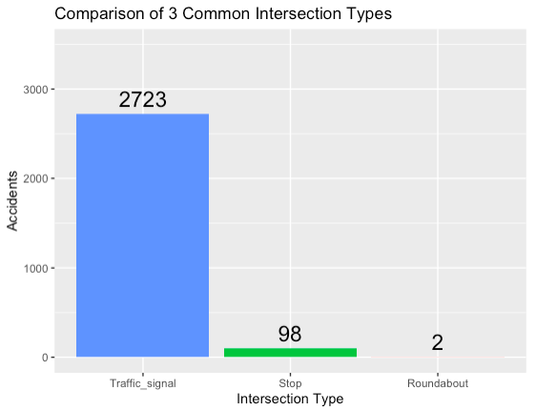
Results
What counties in Michigan have the most accidents?
What type of intersection has the most occurrences of car crashes?

Slide 10
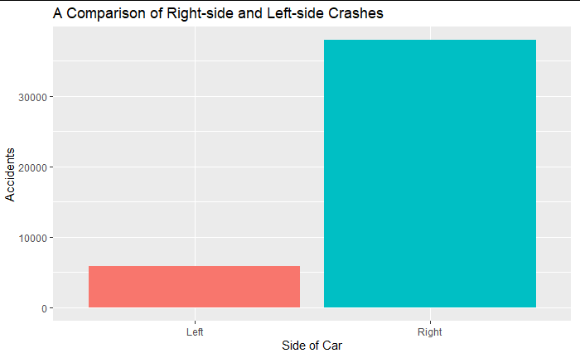
Results
Is there a specific side of the car that gets hit more often?

Slide 11

Conclusion - What are the most significant factors of predicting a car crash?
Traffic signal location of the crash
High visibility
Right-side impact
County in Michigan that the crash occurred
Daytime crash
Fair weather conditions
Winter months

Slide 12
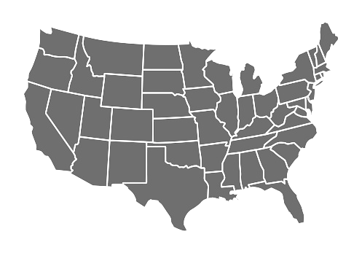
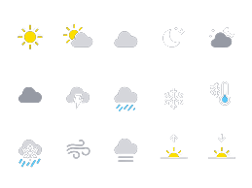
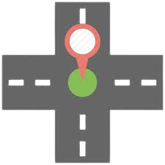
Limitations
We could’ve done similar analysis involving each state in the US and then compare.
Since we only looked at MI, there was not huge variations in weather among each County.
Our analysis would’ve been better if we knew the proportion of accidents to the amount of people that are on the roads.

Slide 13

Future Questions
How can we use our findings to help reduce traffic incidents and increase public safety?
Are other factors more significant in predicting accidents that were not analyzed in this dataset? (ie. gender, age, road surface material, etc.)

Slide 14
References
Moosavi, Sobhan, Mohammad Hossein Samavatian, Srinivasan Parthasarathy, and Rajiv Ramnath. “A Countrywide Traffic Accident Dataset.”, 2019.
Moosavi, Sobhan, Mohammad Hossein Samavatian, Srinivasan Parthasarathy, Radu Teodorescu, and Rajiv Ramnath. "Accident Risk Prediction based on Heterogeneous Sparse Data: New Dataset and Insights." In proceedings of the 27th ACM SIGSPATIAL International Conference on Advances in Geographic Information Systems, ACM, 2019.
United States Census Bureau. B01001 SEX BY AGE, 2020 American Community Survey 5-Year Estimates. U.S. Census Bureau, American Community Survey Office. Web. 17 March 2022. http://www.census.gov/.
https://appsilon.com/ggplot2-bar-charts/

